Slide 1
IMAGE PROCESSING
CSE4019
REVIEW-3
Image Enhancement of Handwritten Examination Scripts

Slide 2

OUR TEAM
G O NARENDRA
SRIVARDHANREDDY BIYAPPU
19BCE1082
19BCE1338

Slide 3
PROBLEM STATEMENT
01
INPUT-OUTPUT
02
DATASET
03
RESULTS
04
CONCLUSIONS
05
CONTENTS

Slide 4
01
PROBLEM STATEMENT
ONLINE EXAMS! ANSWER UPLOADS!

Slide 5


ONLINE EXAMS
Due to onset of the pandemic, all of us are working remotely-CodeTantra, Mettl.
Students may have to upload images for each question.
Due to exam time durations, technical issues, the images received at the evaluator’s end might be blurred/shaken.
Proposed system aims at developing model(s) for image enhancement

Slide 6
02
INPUT-OUTPUT
I/O for the system

Slide 7
I/O OF THE SYSTEM
INPUT
Blurred/Shaken Images serve as the input
OUTPUT
Enhanced Images are to be produced

Slide 8
03
DATASET
KOHTD

Slide 9
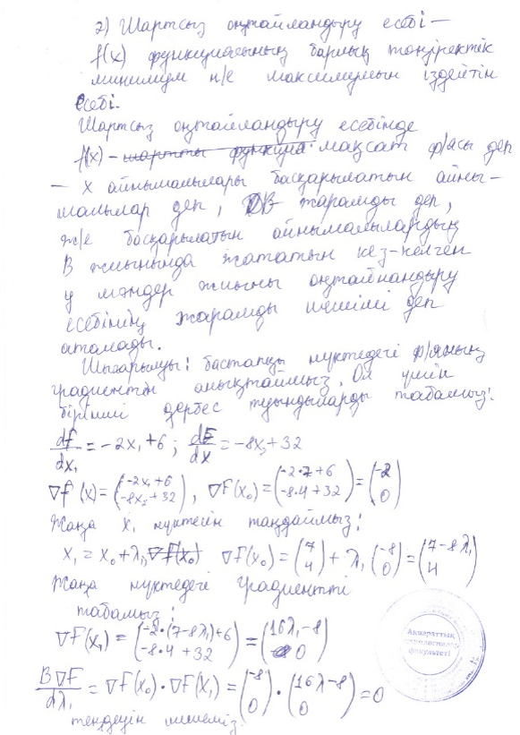



KOHTD DATASET
NAME
NO. OF SCRIPTS
STATISTICS
Kazakh Offline Handwritten Text Dataset
3000 handwritten exam scripts
>140335 image segments
~922010 symbols

Slide 10
RESULTS
04
Our Proposed System and Results

Slide 11
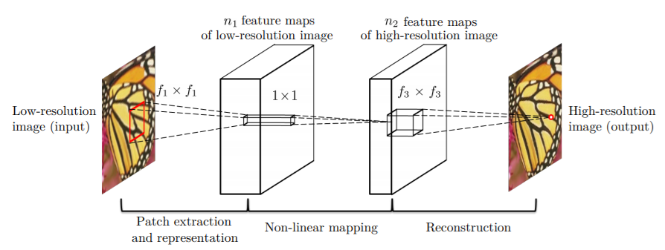
RESULTS
Since all images in the dataset might not be blurred, we have added Gaussian Blur manually.
We have used Super Resolution Convolutional Neural Network (SRCNN)

Slide 12
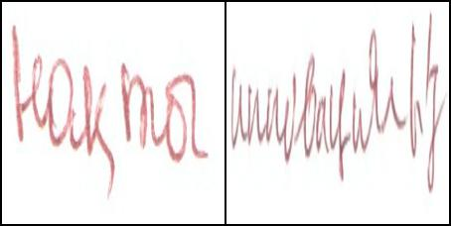
RESULTS (CONTD..)
Original Image

Slide 13

RESULTS (CONTD..)
Blurred Image

Slide 14
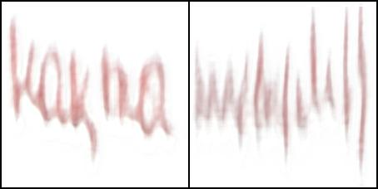
RESULTS (CONTD..)
Our Model Output

Slide 15
05
CONCLUSIONS
System that is proposed to enhance answer script images

Slide 16
THANK YOU

